Slide 1
Clinical Standards For Internal Medicine: Regional Needs And Solutions
Professor Quazi Tarikul Islam
Professor and Head
Medicine Department
Popular Medical College
prof.tarik@gmail.com

Slide 2
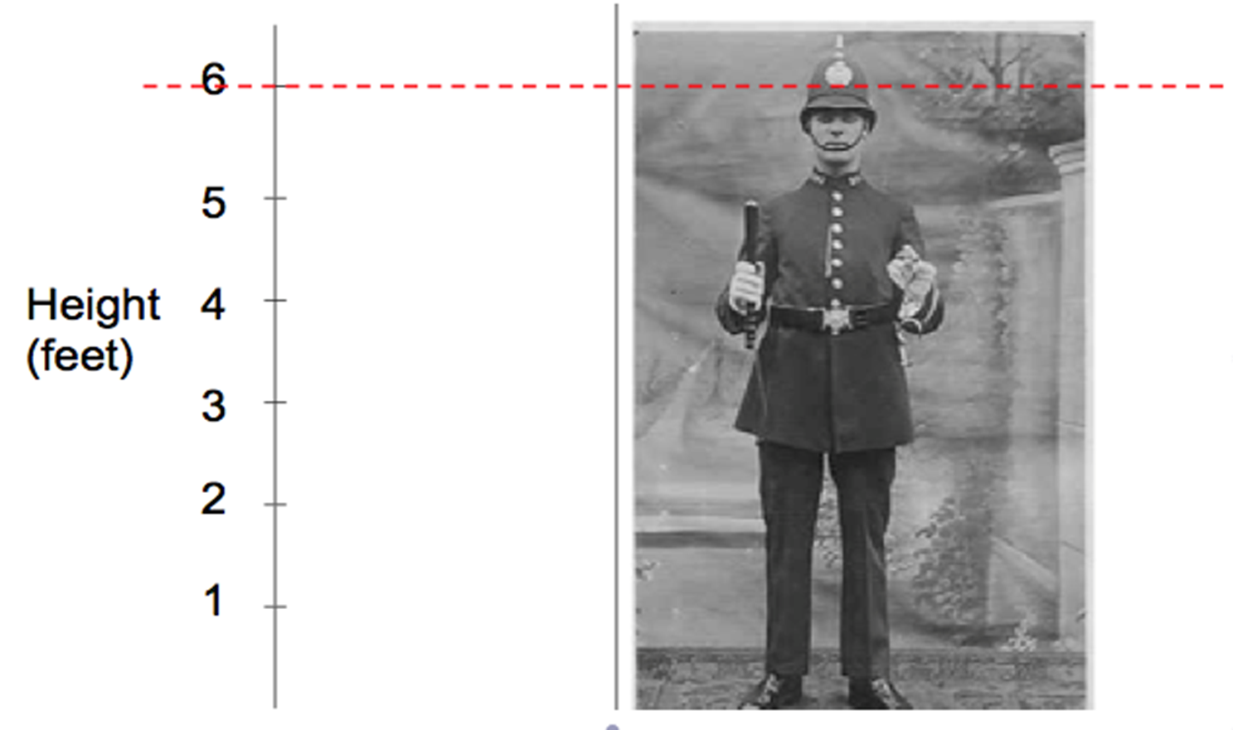
What is Standard ?

Slide 3


Slide 4
Definition of Standard of care
A Clinical Care Standard is a small number of quality statements that describe the care patients should be offered by health professionals and health services for a specific clinical condition or defined clinical pathway in line with current best evidence

Slide 5
Standards of care
A standard of care can also refer to
  Informal or formal guidelines generally accepted in the medical community
  Developed by a specialist society or organization
  Sometimes simply developed over time or as the result of clinical trial findings
  That standard care, experts would agree with as most appropriate or "best practice"

Slide 6
Why clinical care standard is needed?
Avoid malpractice
Develop professionalism
Provide uniform standard care in clinical medicine

Slide 7
Need for clinical standard care
Disease patterns and other bio- ethical issues are different in different countries
Needs standard clinical care for each countries
Regional guidelines for specific diseases; e.g. asthma guideline for Indian sub continent

Slide 8
Standard care needs standard settings
Country wise
Region wise
Disease pattern wise

Slide 9
Over the past decade, clinical guidelines have increasingly become a familiar part of clinical practice
Every day, clinical decisions at the bedside, rules of operation at hospitals and clinics, and health spending by governments and insurers are being influenced by guidelines
The development and implementation of (evidence-based) clinical practice guidelines - is one of the promising and effective tools for improving the quality of care

Slide 10
However, many guidelines are not used after dissemination
Implementation activities frequently produce only moderate improvement
The guideline recommendations are followed in on average 67% of the decisions
There is a large variation between different physicians and between different guidelines

Slide 11
Who is internist ?
Internal medicine physicians are specialists who apply scientific knowledge and clinical expertise to the diagnosis, treatment, and compassionate care of adults across the spectrum from health to complex illness

Slide 12
Core competencies of the internist
1. Patient care
2. Medical knowledge
3. Communication skills
4. Professionalism, ethical, and legal issues
5. Organizational planning and service management skills
6. Academic activities — education and research
Core Competencies of the European Internist: A discussion paper
Runolfur Palsson et al
European Journal of Internal Medicine 18 (2007) 104–108

Slide 13
In our setting( Bangladesh)
Strong points
  Clinical diagnosis
  Management of emergencies despite constrain
  Skilled at medical procedures
  Universal health coverage program
Weak points
  Documentations (Set Clinical audit)
  Evidence based practice
  Lack of awareness in prevention
  Inadequate health budget

Slide 14
In our setting( Bangladesh)
Professionals are busy with multifaceted work load
Lack of motivation
No health insurance policy
No legal binding for use of guidelines
Clinicians are confident on clinical diagnosis based on their long experience

Slide 15
In our country
Majority of clinical care guidelines have adopted from international guidelines for non communicable diseases (DM, HTN, IHD, COPD, Bronchial Asthma, COPD, Malignancy so on)
Regarding infectious diseases - own guidelines on the basis of evidence but enlightened from WHO guideline (Dengue, Chikungunya, Filaria, Malaria, Vis. Lieshmania, Diarrhea, and so on) prepared by the specialist in collaboration with the disease control center of health services

Slide 16
Rule and Role
Rule and role of professional bodies
There are some individual professional bodies/societies initiatives
Central professional bodies like medical association have no rule and role

Slide 17
Countries in Asia
Singapore
Thailand
Japan
China
South Korea
Good clinical standard care
KSA
Oman
Israel
UAE

Slide 18
The changing face of internal medicine: patient centered care
Patient centered care is the gold standard and ‘no decision about me, without me’
A ‘goal-oriented’ principle should consider in complex multi-morbidities
The barrier is deeply rooted in a disease-outcome-based paradigm

Slide 19
The culture of modern medicine has prioritized optimal disease management according to guidelines and population goals without asking what patients want
Doing ‘what is right for the patient’ should be based on trust
Patients and internists must therefore meet as equals: ‘I’ and ‘you’ should be replaced by ‘we’

Slide 20
Standardized framework for adaptation needed
Methods and principles for developing high quality guidelines
  Now well established
  Though no internationally accepted method available for adapting them to local contexts
  Few need to evaluate the rigor, efficiency, and transparency of proposed processes according to a recent review

Slide 21
Lack of international standards can lead to recommendations adapted on the basis of tradition, anecdote, or poor quality evidence
Mitigation of this risk can be possible by
  Improving documentation
  Involving methodologists to translate evidence to recommendations

Slide 22
Variables/Determinants
Health budget
Per capita expenditure on health
Political commitment of the government
Social context
Race/ethnicity

Slide 23
Conflicts – how to solve ?
ADA/IDF/WHO
AHA/ESC/who
Ara/ilar
Ats/gold
Isn/aan

Slide 24
Way to Success
Even in 21st century, despite all of the advances, the patient–physician interaction remains the cornerstone of the practice of internal medicine
Incorporation of core competencies in training curricula throughout the globe is now vital.
Patient centered care, guidelines and population goals, ‘goal-oriented’ principle etc. are essentials
Needs a collaborative effort to develop and endorse a consensus

Slide 25


